Slide 1
Broad Objective
How can we reduce material Planner efforts?

Slide 2
Potential Solutions
The user dashboard can integrate all needed data and analysis into one location for the planner.
Provide Key Performance Indicator (KPIs) on dashboard that could guide material planner to reduce their daily efforts.
Recommend best practices for the material planner.
“What-if Analysis” The dashboard can allow material planner for creating “what if” scenarios based on alternative suppliers, transportation, stock, etc.
?
?

Slide 3
# 1 Dashboard
Provide Key Performance Indicator (KPIs) on dashboard that could guide material planner to reduce their daily efforts.
KPIs
Health Status (KPI # 1)
Part Ranking (KPI # 2)
Questions to be investigated:
What are the KPIs for the material planner to reduce their daily efforts?*
What are fields/columns in datasets to generate these KPIs?*
What can be an Application logic/Algorithm to derive these KPIs?
What are use case scenarios/test cases scenarios to validate the results?
*We have partial answer

Slide 4

Decision Tree – KPI # 1
Algorithm, Application Logic, Rulesets
Material Transaction
Demand Date
MRP Element
Change Qty
Total Qty
?
Stock DoS (number, in Days)
Material Config.
Safety Stock
Planning Time Fence
Safety Time
Planning Calendar
?
KPI # 1
AL
Health Status (number , 0-100 in %)
First Receipt DoS (number, in Days)
AL
Exception

Slide 5
Decision Tree – KPI # 1
Algorithm, Application Logic, Rulesets
Supply
Purchase Order #
Trailer ID
Source of Shipment
Dest. of Shipment
ETA to Dest.
Supply TS
Weather
Traffic
?
Stock DoS (number, in Days)
KPI # 1
AL
Health Status (number , 0-100 in %)
First Receipt DoS (number, in Days)
AL
Material Config.
Safety Stock
Planning Time Fence
Safety Time
Planning Calendar
?
Exception

Slide 6
Decision Tree – KPI # 1
Algorithm, Application Logic, Rulesets
Supply
Purchase Order #
Trailer ID
Source of Shipment
Dest. of Shipment
ETA to Dest.
Supply TS
Weather
Traffic
?
Stock DoS (number, in Days)
Exception
Exception ID (PK)
Exception Msg
KPI # 1
AL
Health Status (number , 0-100 in %)
First Receipt DoS (number, in Days)
AL
Material Config.
Safety Stock
Planning Time Fence
Safety Time
Planning Calendar
?
Material Transaction
Demand Date
MRP Element
Change Qty
Total Qty
?
Exception

Slide 7
Decision Tree – KPI # 2
Algorithm, Application Logic, Rulesets
Supply
Purchase Order #
Trailer ID
Source of Shipment
Dest. of Shipment
ETA to Dest.
Supply TS
Weather
Traffic
?
Stock DoS (number, in Days)
Exception
Exception ID (PK)
Exception Msg
First Receipt DoS (number, in Days)
AL
Exception
KPI # 1
Health Status (number , 0-100 in %)
AL
Material Config.
Safety Stock
Planning Time Fence
Safety Time
Planning Calendar
?
Material Transaction
Demand Date
MRP Element
Change Qty
Total Qty
?
KPI # 2
Part Ranking Algorithm
Part Ranking
It calculate the probability that an order will be early or late and by how many days for the next delivery (Markov chain).

Slide 8
#2 Best practices for material planner.
Recommend best practices for the material planner
Material Planner spends a significant amount of his/her daily time in reviewing exception messages.
Improve quality of decisions made by reducing overall number of exceptions
Questions to be investigated
What are the most frequent exception messages generated?*
What are the root causes of some of the highly generated exception messages? *
How could we reduce/avoid the generated exception messages in order to reduce the material planner effort?*
How can we validate that the recommended best practices are effective?
*We have partial answer

Slide 9
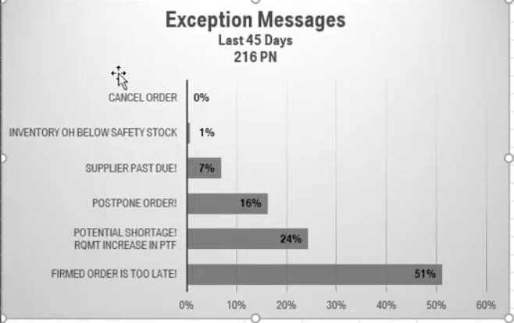
#2 Best Practice
ID | Exception Message
10 | Firmed order is too late
30 | Potential shortage! Rqmt increase in PTF
15 | Postpone order!
4 | New order, Supplier past due!
96 | Inventory on hand is below safety stock
(Image credit : Joshua)

Slide 10
Rule book
Credit: FhG team - Rulebook
Exception | Message | Scenarios | Desc. | When | Recommendation /Purpose
Exception 96 | Inventory on hand is below safety stock | Ignore_Inventory_On_Hand_Is_Below_Safety_Stock
Exception 7 | Supplier past due | Supplier_Past_Due
Exception 15 | Postpone Order | Ignore_Exception, Zero_Out_Exception_15
Exception 30 | Potential shortage, requirement increase in PTF | Ignore_Potential_Shortage, Pull_In_ Shortage_Quantity, Expedite_ Shortage_Quantity
Exception 10 | Firmed order is too late. | Ignore_Exception_10, Expedite_Order_for_Exception_10
Supply
Purchase Order #
Trailer ID
Source of Shipment
Dest. of Shipment
ETA to Dest.
Supply TS
Weather
Traffic
?
Material Config.
Safety Stock
Planning Time Fence
Safety Time
Planning Calendar
?
Material Transaction
Demand Date
MRP Element
Change Qty
Total Qty
?

Slide 11
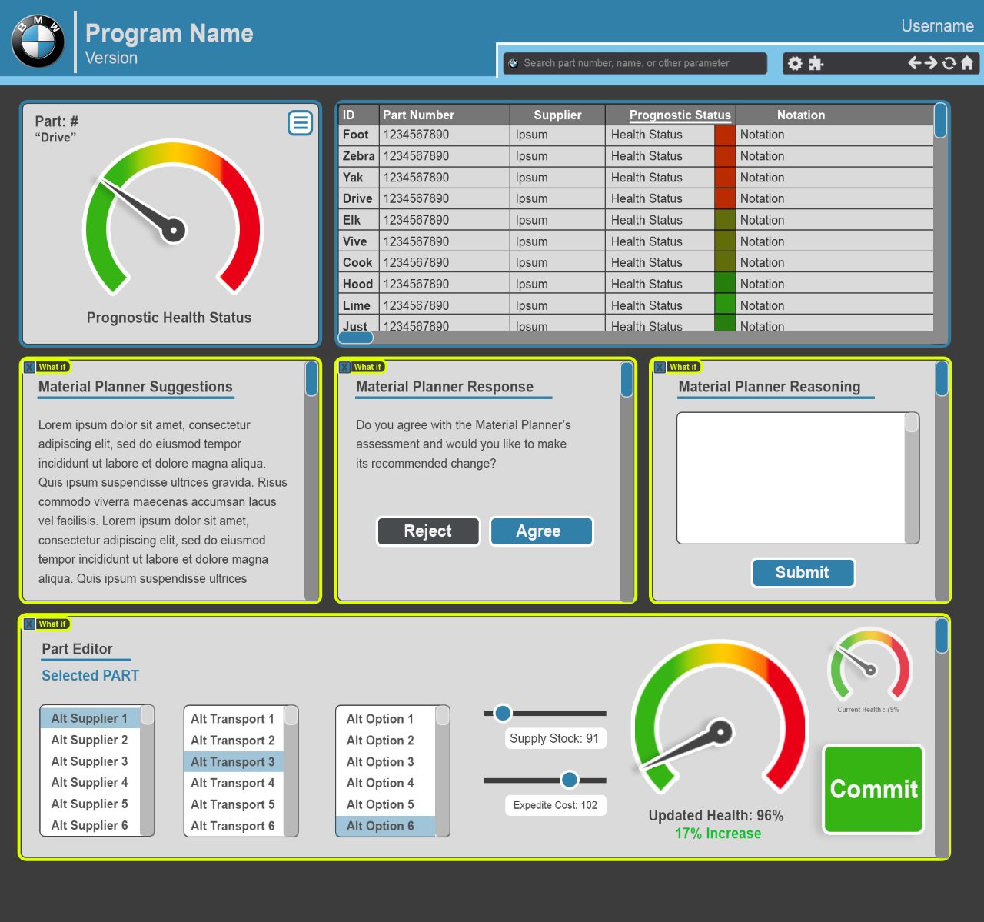
#3 What-if Analysis
Feedback from Material Planner
The material planner suggestion will be displayed along with a box to collect the Planner’s feedback on why they accepted or rejected
What-if Analysis
The dashboard will also allow for creating “what if” scenarios based on alternative suppliers, transportation, stock, etc.

Slide 12
Summary…
How can we reduce material Planner daily efforts?
Dashboard
KPIs, Data analysis on one dashboard to reduce material planners' effort
Recommend best practice
Reduce Exception messages to reduce material planners' efforts
What-if analysis
“what if” analysis for material planner (based on alternative suppliers, transportation, stock, etc.) to test and optimize different scenarios.

Slide 13
Back up

Slide 14
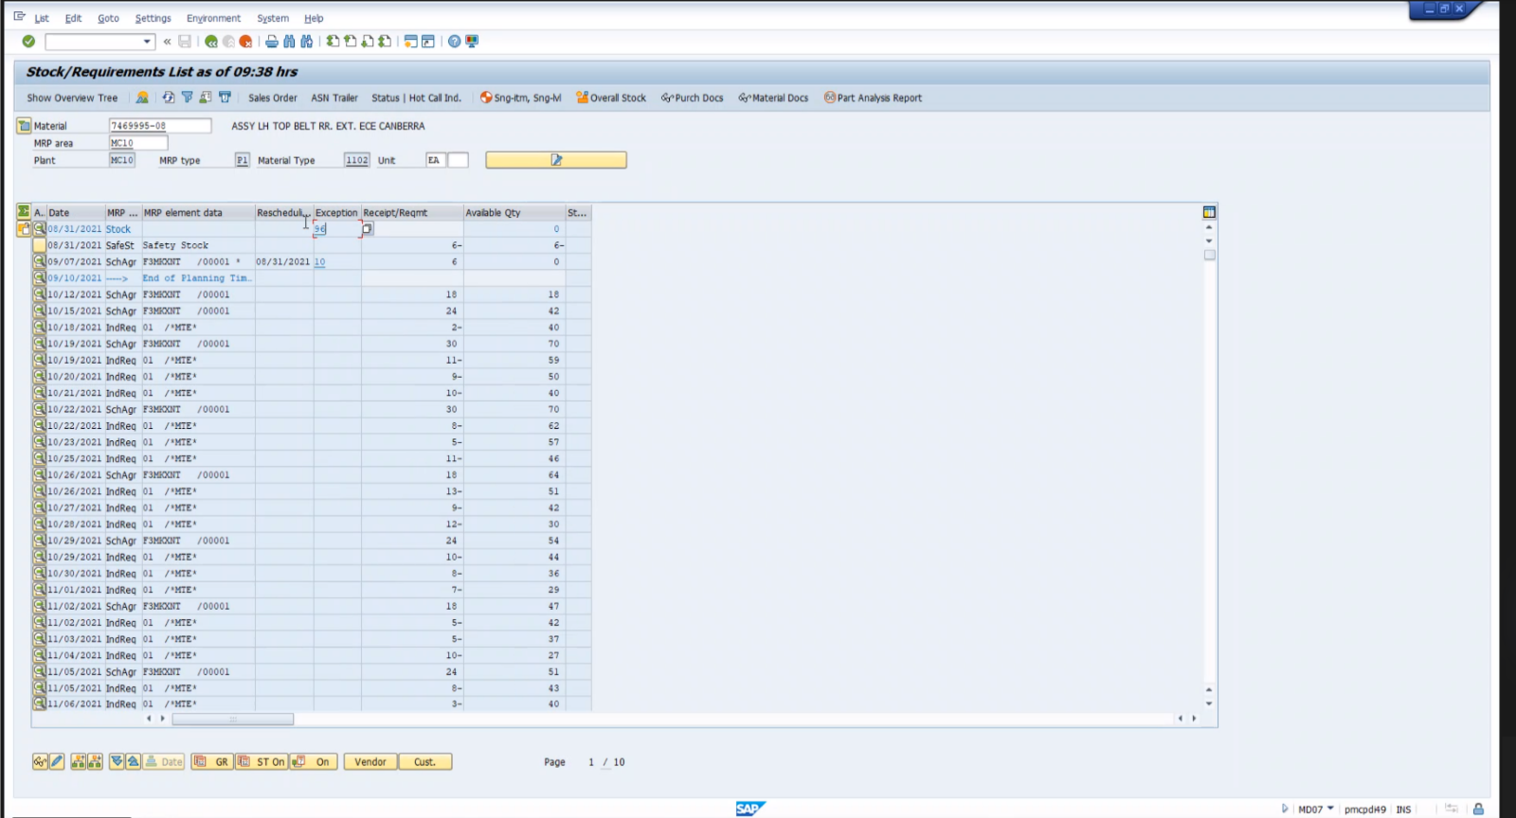
Exception 96 – Inventory on hand is below safety stock (Scenario – 1 - Ignore_Inventory_On_Hand_Is_Below_Safety_Stock)
In a new revision of the part (new AI level), a new part may deliver earlier than is planned, and the new revision level copies the settings of the current part. It forces the scheduled agreement to deliver a little bit earlier. Or when you run out of parts.
When: The first schedule agreement time is one to two weeks before the demand.
Recommendation: This is a new revision level part, ensure the first delivery timing is agreed with the supplier.
Material Config.
Safety Stock
Planning Time Fence
Safety Time
Planning Calendar
?
Material Transaction
Demand Date
MRP Element
Change Qty
Total Qty
?
Credit: FhG team - Rulebook

Slide 15
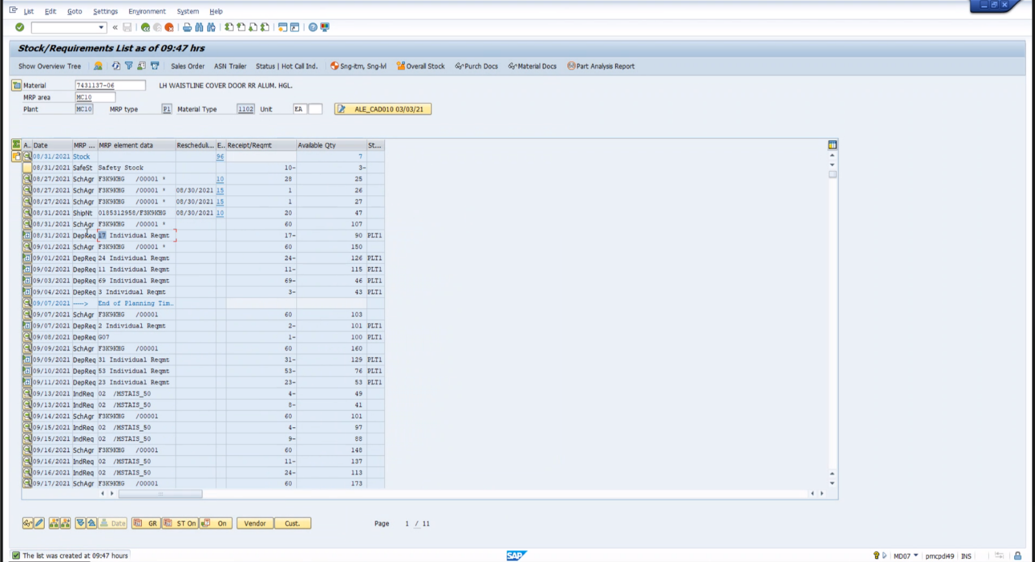
Exception 96 – Inventory on hand is below safety stock (Scenario – 2 - Expedite_Inventory_On_Hand_Is_Below_Safety_Stock)
Inventory on hand is below safety stock. When you run out of parts.
When: The available quantity for today is less than the demand for today.
Recommendation: Urgent expedite order is required. Expedite order quantity should cover production for today and tomorrow.
Material Config.
Safety Stock
Planning Time Fence
Safety Time
Planning Calendar
?
Material Transaction
Demand Date
MRP Element
Change Qty
Total Qty
?
Credit: FhG team - Rulebook

Slide 16
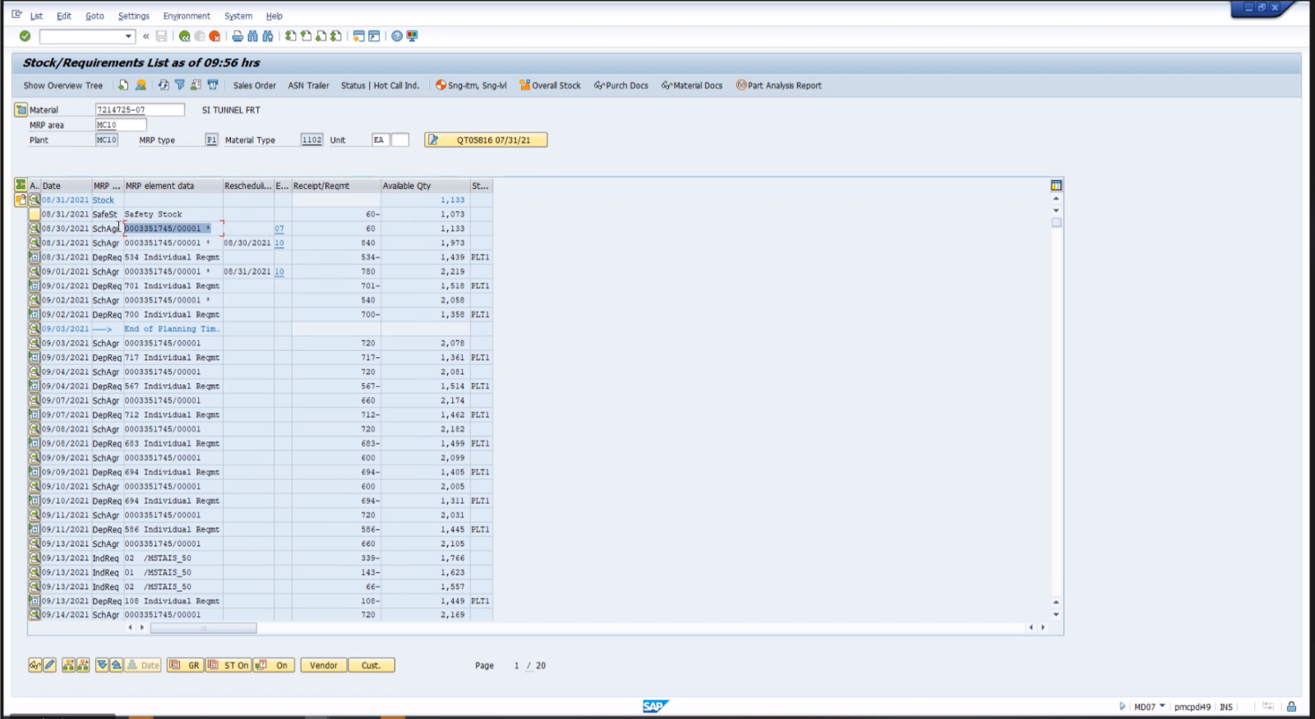
Exception 7 – Supplier past due ( Supplier_Past_Due )
Advance Shipping Notification (ASN) is not in SAP. The scheduled agreement for a prior day has not changed to a shipping note.
When: The scheduled agreement for a prior day (to today) has not changed to a ship note. And the scheduled agreement has exception 7.
Recommendation: Confirm if supplier is past due and confirm ASN is correct and in SAP. Verify production coverage and add to the next regular truck or expedite if needed.
Material Config.
Safety Stock
Planning Time Fence
Safety Time
Planning Calendar
?
Material Transaction
Demand Date
MRP Element
Change Qty
Total Qty
?
Supply
Purchase Order #
Trailer ID
Source of Shipment
Dest. of Shipment
ETA to Dest.
Supply TS
Weather
Traffic
?
Credit: FhG team - Rulebook

Slide 17
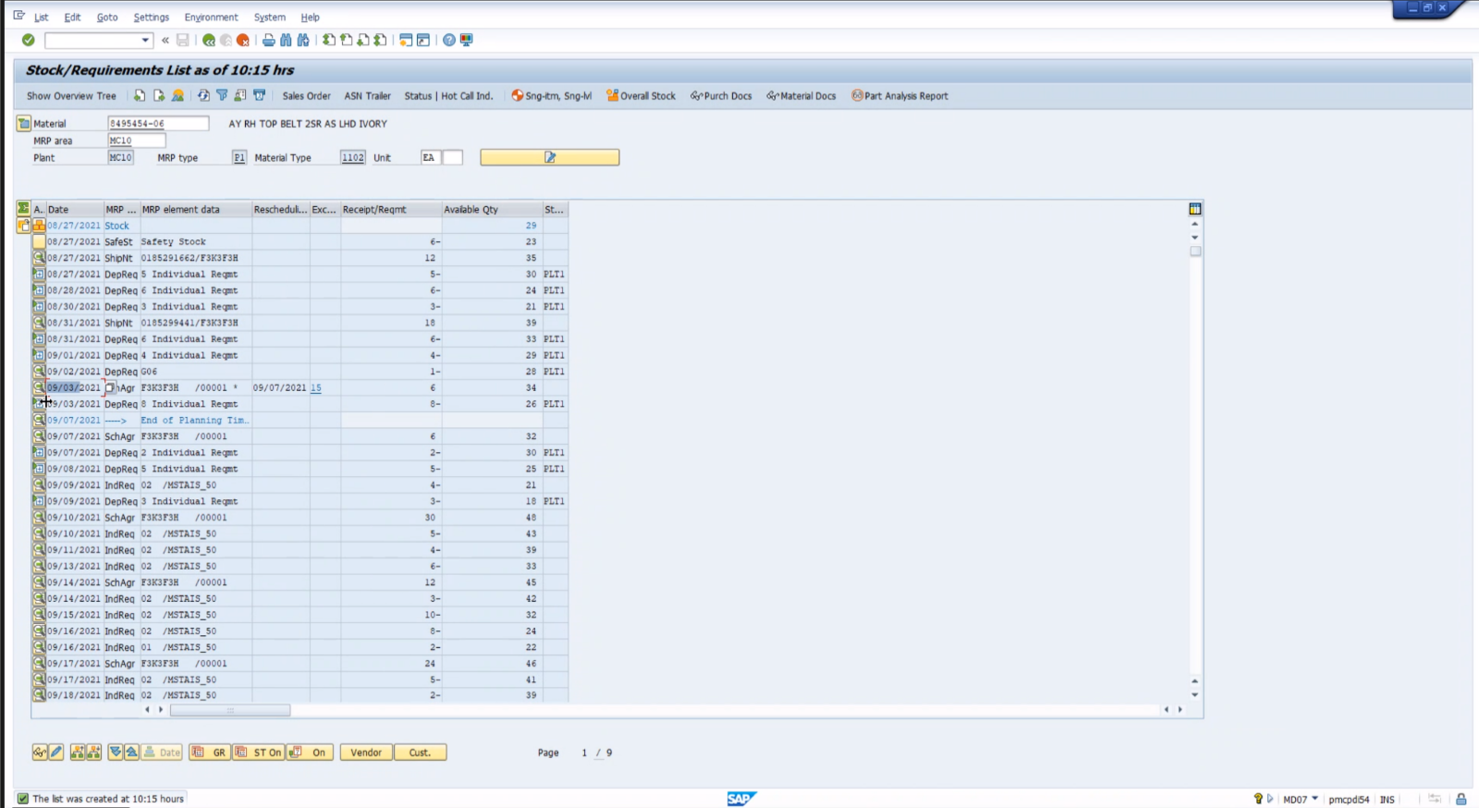
Exception 15 – Postpone Order (Scenario # 1 - Ignore_Exception)
Delay an order because the total inventory is over what the safety lead time value coverage is for that part.
When: There is a scheduled agreement with a 15 exception, There are future Dep Requirments with Receipt/Reqmt greater than the exception quantity
Recommendation: Ignore this message unless there is management direction to push out the deliveries.
Material Config.
Safety Stock
Planning Time Fence
Safety Time
Planning Calendar
?
Material Transaction
Demand Date
MRP Element
Change Qty
Total Qty
?
Supply
Purchase Order #
Trailer ID
Source of Shipment
Dest. of Shipment
ETA to Dest.
Supply TS
Weather
Traffic
?
Credit: FhG team - Rulebook

Slide 18
Exception 15 – Postpone Order (Scenario # 2 - Zero_Out_Exception_15)
Delay or reduce the quantity because you don’t need those parts based on the configured settings.
When: There is a scheduled agreement with a 15 exception, There future DepRqmt with Receipt/Reqmt are less than the available inventory + the exception quantity
Recommendation: Zero out the receipt requirement of the scheduled agreement having the exception.”
Material Config.
Safety Stock
Planning Time Fence
Safety Time
Planning Calendar
?
Material Transaction
Demand Date
MRP Element
Change Qty
Total Qty
?
Supply
Purchase Order #
Trailer ID
Source of Shipment
Dest. of Shipment
ETA to Dest.
Supply TS
Weather
Traffic
?
Credit: FhG team - Rulebook

Slide 19
Exception 30 – Potential shortage, requirement increase in PTF (Scenario # 1 - Ignore_Potential_Shortage)
For a scheduled agreement outside the planning time fence we believe the quantity should be added to an earlier shipment within the planning time fence if today is the day before the next the pickup date.
When: For the available stock at the end of the previous day before the last shipment inside the planning time fence, If the number of days covered including available safety stock is greater than the number of days to the next delivery date + 1.
Recommendation: Production is covered, pull in is up to planner discretion.
Material Config.
Safety Stock
Planning Time Fence
Safety Time
Planning Calendar
?
Material Transaction
Demand Date
MRP Element
Change Qty
Total Qty
?
Credit: FhG team - Rulebook

Slide 20
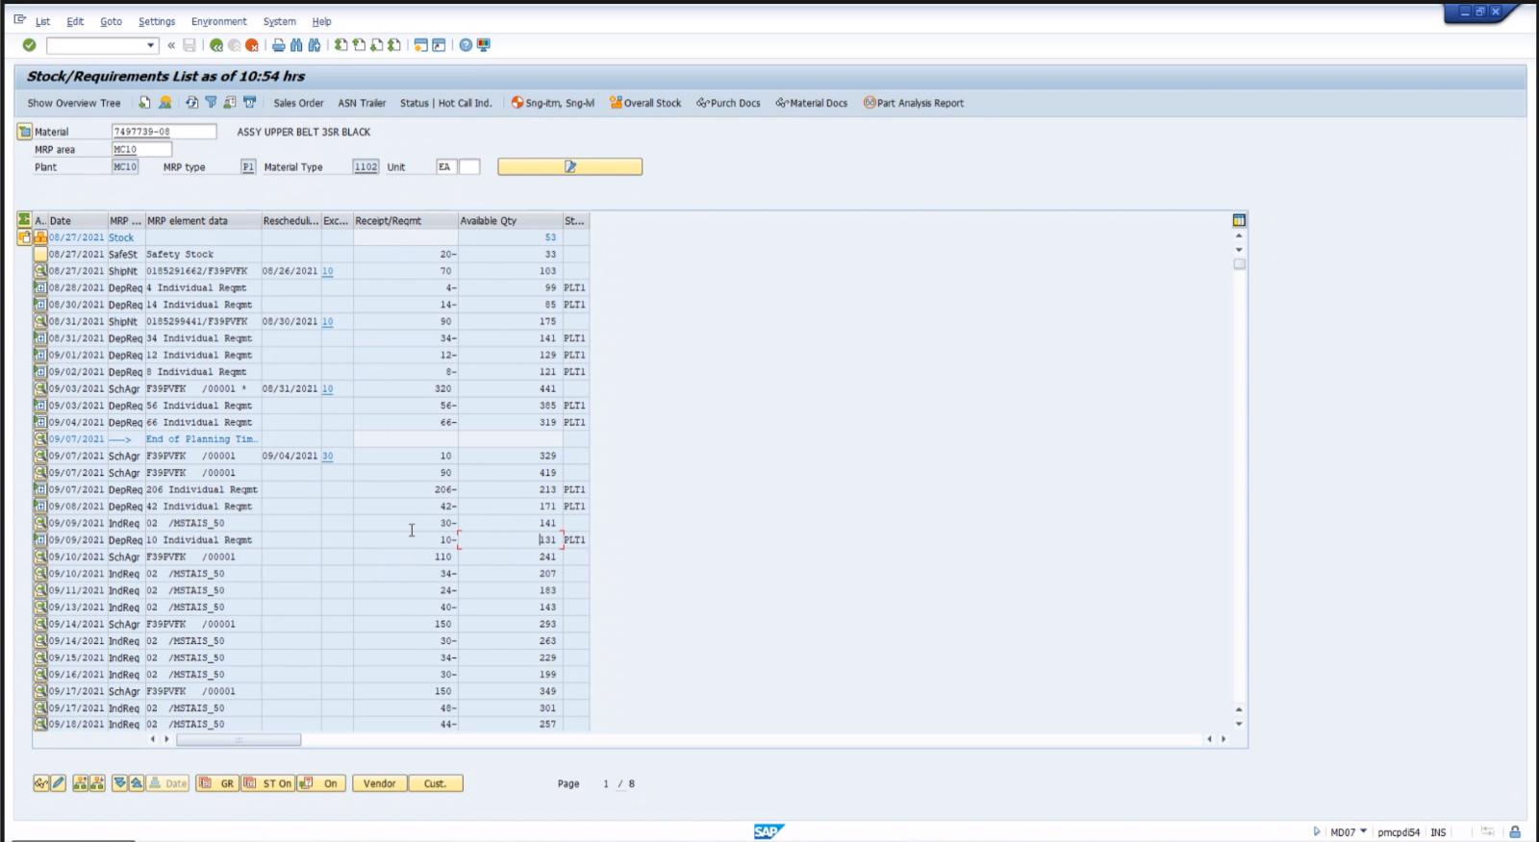
Exception 30 – Potential shortage, requirement increase in PTF (Scenario # 2 - Pull_In_ Shortage_Quantity)
For a scheduled agreement outside the planning time fence we believe the quantity should be added to an earlier shipment within the planning time fence if today is the day before the next the pickup date.
When: For the available stock at the end of the previous day before the last shipment inside the planning time fence, If the number of days covered including available safety stock is less than or equals the number of days to the next delivery date And today is before the pickup date, (where Pickup date := scheduled agreement date - Planned delivery time)
Recommendation: “ Add the exception message receipt/requirement to the next scheduled agreement date after today. If the receipt/reqmnt quantity is less than the safety stock then this message was created is due to safety stock on the part. “
Material Config.
Safety Stock
Planning Time Fence
Safety Time
Planning Calendar
?
Material Transaction
Demand Date
MRP Element
Change Qty
Total Qty
?
Credit: FhG team - Rulebook

Slide 21
Exception 30 – Potential shortage, requirement increase in PTF (Scenario # 3 -Expedite_ Shortage_Quantity)
For a scheduled agreement outside the planning time fence we believe the quantity should be added to an earlier shipment within the planning time fence if today is the day before the next the pickup date.
When: The available stock at the end of the previous day before the last shipment inside the planning time fence, If the number of days covered including available safety stock is less than or equals the number of days to the next delivery date And today is equal to or after the pickup date (where Pickup date := scheduled agreement date - Planned delivery time),
Recommendation: Create an expedite order for Receipt/Reqmt in the exception.”
Material Config.
Safety Stock
Planning Time Fence
Safety Time
Planning Calendar
?
Material Transaction
Demand Date
MRP Element
Change Qty
Total Qty
?
Credit: FhG team - Rulebook

Slide 22
Exception 10 – Firmed order is too late.(Scenario # 1 - Ignore_Exception_10)
The Planning time fence enables the ability to not have any changes to a supplier within a certain time frame. For example, if a supplier picks up on Wednesday and Friday. SchAgr (Schedule Agreements) represent the quantity that is sent to the supplier via EDI. As we progress through the week Schedule Agreements move into the Planning Time Fence. If changes are needed when the Agreement is within the Planning Time Fence, SAP cannot automatically change the agreement. Without the planning time fence, when MRP is run, if there is a demand increase the system will add the difference to a Scheduled Agreement . The Planning time fence creates a hard barrier so that the material controller needs to make modifications themselves, MRP cannot make the changes. Within the Planning time fence, the order is firmed. When a Firmed order is too late, the pieces need to be pulled in sooner. The quantity coming from the supplier is arriving too late. The exception message will stay until the quantity arrives from the supplier Setting up an expedite will clear the exception. For suppliers with longer lead times you must think a week ahead.
When: For the available stock at the end of the previous day to the exception, If the number of days covered is greater than the number of days to the next delivery date.
Recommendation: Production is covered through the next delivery, ensure there is no delay with the shipment.
Material Config.
Safety Stock
Planning Time Fence
Safety Time
Planning Calendar
?
Material Transaction
Demand Date
MRP Element
Change Qty
Total Qty
?
Credit: FhG team - Rulebook

Slide 23
Exception 10 – Firmed order is too late.(Scenario # 2 - Expedite_Order_for_Exception_10)
If there is any risk to production that parts will not be available we have the green light to do an expedite. Especially if we can’t get parts added to a truck because they are within the planning time fence. The exception message will stay until the quantity arrives from the supplier. Setting up an expedite will clear the exception. For suppliers with longer lead times you must think a week ahead.
When: For the available stock at the end of the previous day to the exception, If the number of days covered including available safety stock is less than or equals the number of days to the next delivery date
Recommendation: “Production is not covered through the next delivery date, please create expedited order for the expected shipment quantity. “
Material Config.
Safety Stock
Planning Time Fence
Safety Time
Planning Calendar
?
Material Transaction
Demand Date
MRP Element
Change Qty
Total Qty
?
Credit: FhG team - Rulebook

Slide 24
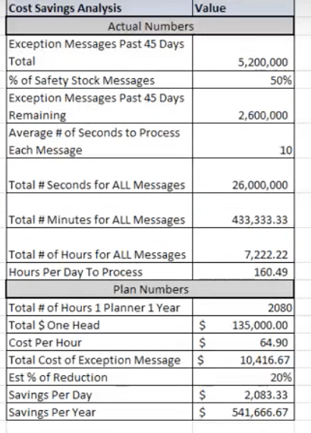
# 2 Best Practice
Recommend best practices for the material planner
Questions to be investigated
What are the root causes of some of the highly generated exception messages?
How could we reduce/avoid the generated exception messages in order to reduce the material planner effort?
How can we validate that the recommended best practices are effective?

Slide 25
Part Ranking
A part ranking algorithm using Markov Chain is being developed
Based on historical data, we will be able to calculate the probability that an order will be early or late and by how many days for the next delivery.
Data Needed
Supplier number
Part number/description
Expected receipt date
Actual receipt date
Data Extracted From
Zgrve Reports
Material (part #)
Supplier #
GR date (actual receipt date)
MD04 Reports
Material
Demand_Date/”ShipNt” in MRP Element

